Slide 1
Exercise: T11 - Consensus
Prove T11 using perfect induction
Number | Theorem | Name
T11 | (B•C) + (B•D) + (C•D) = (B•C) + (B•D) | Consensus

Slide 2
Exercise: T11 - Consensus
Prove T11 using other theorems and axioms
Number | Theorem | Name
T11 | (B•C) + (B•D) + (C•D) = (B•C) + (B•D) | Consensus

Slide 3
Simplifying Boolean Equations
Example 3:
Y = A’BC + A’ Recall: A’ = A

Slide 4
Simplifying Boolean Equations
Example 3 Solution:
Y = A’BC + A’ Recall: A’ = A
= A’ T9’ Covering: X + XY = X
or
= A’(BC + 1) T8: Distributivity
= A’(1) T2’: Null Element
= A’ T1: Identity

Slide 5
Simplifying Boolean Equations
Example 4:
Y = AB’C + ABC + A’BC

Slide 6
Simplifying Boolean Equations
Example 4 Solution :
Y = AB’C + ABC + A’BC
= AB’C + ABC + ABC + A’BC T3’: Idempotency
= (AB’C+ABC) + (ABC+A’BC) T7’: Associativity
= AC + BC T10: Combining

Slide 7
Simplifying Boolean Equations
Example 5:
Y = AB + BC +B’D’ + AC’D’

Slide 8
Simplifying Boolean Equations
Example 5 Solution :
Y = AB + BC +B’D’ + AC’D’
Y = AB + BC + B’D’ + (ABC’D’ + AB’C’D’) T10: Combining
= (AB + ABC’D’) + BC + (B’D’ + AB’C’D’) T6: Commutativity
T7: Associativity
= AB + BC + B’D’ T9: Covering

Slide 9
Simplifying Boolean Equations
Example 6:
Y = (A + BC)(A + DE)
Apply T8’ first when possible: W+XZ = (W+X)(W+Z)

Slide 10
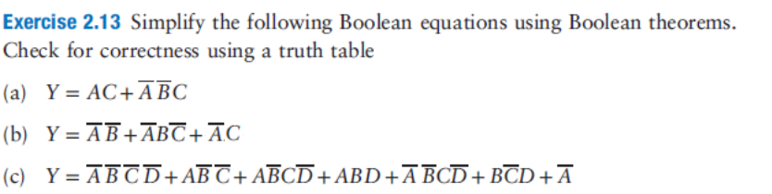
Esercizi

Slide 11
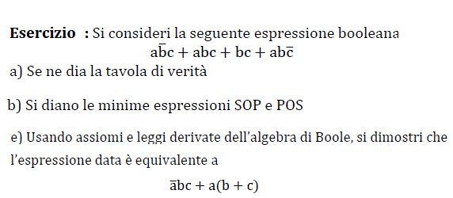
Esercizi

Slide 12
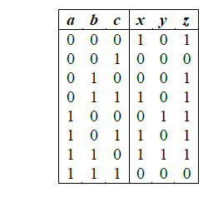
Esercizi
Date le funzioni x,y,z definite dalla tabella di verità:
- Scrivere x,y,z in forma canonica SOP e POS
- Semplificare le forme SOP

Slide 13

Esercizi

